Slide 1
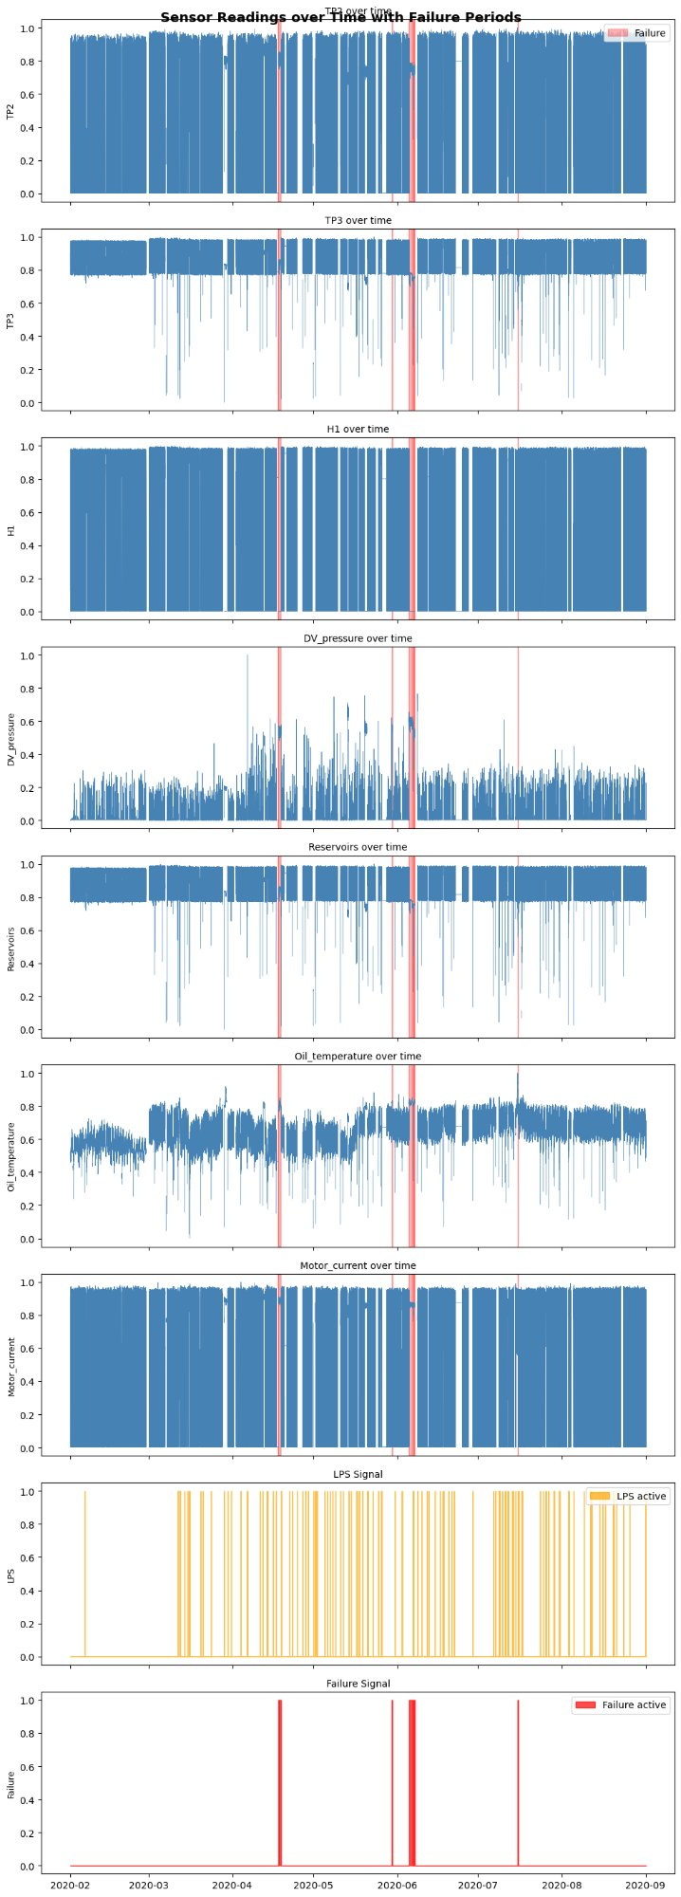
Predictive Maintenance
for Railway Air Compressor
MetroPT-3 Dataset
🎯 Goal: Predict compressor failures
15.2M
17
1.97%
rows
sensors
failures
Sensor Readings Over Time

Slide 2
Dataset Description
📊 15,169,948 rows
Sensor Types
One per sensor event (~10 sec)
7 Analog Sensors
Pressure, Temperature, Motor Current — Numerical continuous
📅 March – August 2020
Real operational data
8 Digital Sensors
COMP, DV_eletric, Towers, MPG... — Boolean (0/1)
🔢 17 columns
Target: Failure
7 analog + 8 digital + timestamp + target
Binary — 1 during failure windows, 0 otherwise
✅ No missing data
Time Series
No duplicated rows
Timestamp column — chronological structure is key

Slide 3
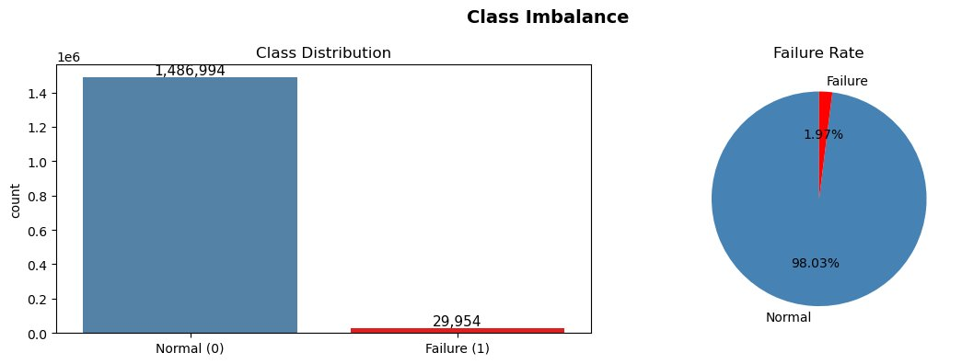
The Core Challenge: Class Imbalance
98.03%
Normal samples
1.97%
Failure samples
⚠️ Accuracy is misleading here! A model predicting everything as 'Normal' gets 98% accuracy — but catches ZERO failures. We must focus on Recall and F1 for Class 1.

Slide 4
EDA — Sensor Readings Over Time
Key Insights
🔴 Red shaded areas mark failure periods across all sensors
📉 DV_pressure spikes clearly before failures
🌡️ Oil_temperature rises steadily pre-failure
⏱️ Time gaps visible — train stops

Slide 5
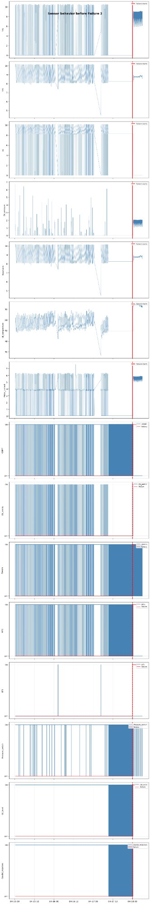
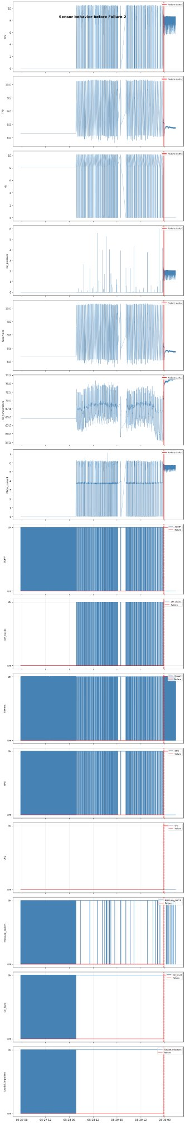
EDA — Sensor Behavior Before Failure
Failure 1
Failure 2
Red vertical line marks the exact moment the failure begins — sensors show clear pattern changes

Slide 6
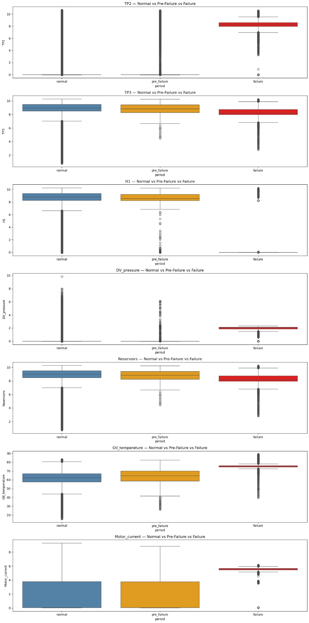
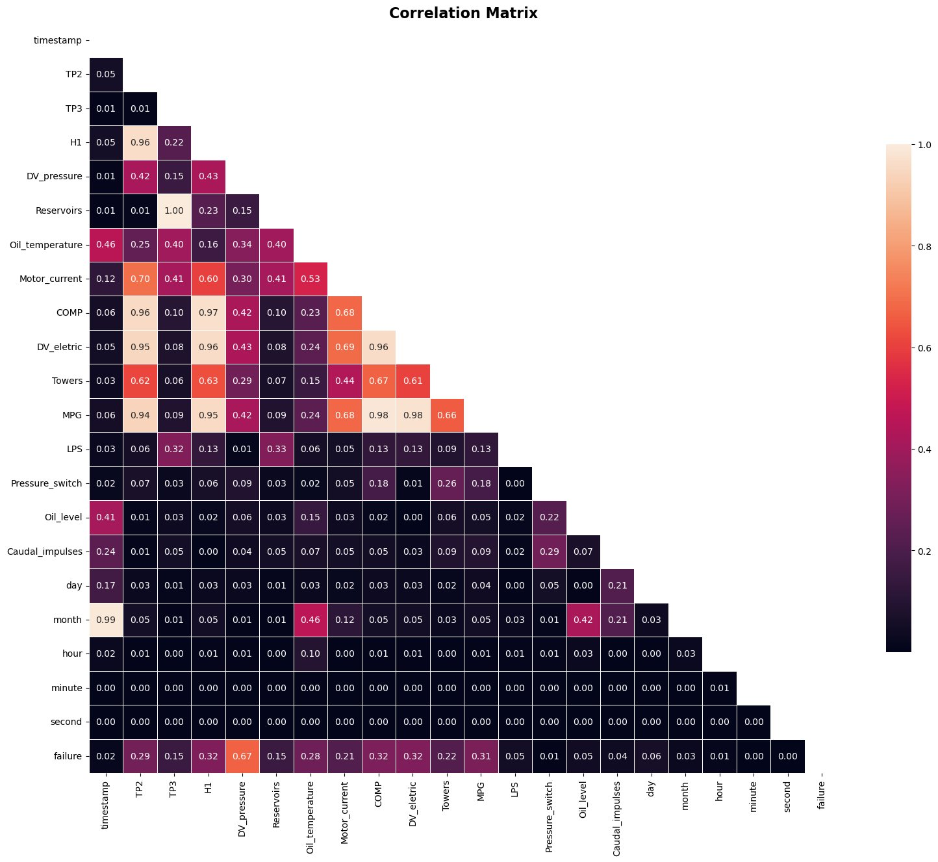
EDA — Normal vs Pre-Failure vs Failure & Correlation
Sensor Values by Period
Correlation Matrix

Slide 7
Modeling Approach
📅
⚖️
🌲
🎯
📊
Chronological
Split
Resampling
Strategy
Random Forest
Classifier
Threshold
Tuning
Evaluation
Class 1 only
Why Chronological Split?
Why Custom Threshold (0.15)?
• Time series data cannot be shuffled • Future data must never leak into training • Train on failures 1,2,3 → Test on failure 4 • This is how real predictive maintenance works
• Default 0.5 catches almost no failures • Model max probability: ~0.42 on rare events • Lower threshold = more failures caught • Missing a failure >> false alarm cost

Slide 8
Resampling Strategies Tested
Baseline
Undersample
50/50
Undersample
70/30
SMOTE 0.05 ⭐
SMOTETomek
0.05
Chronological split only
Threshold 0.15
Randomly removes majority
samples to balance classes
Less aggressive — keeps
more majority data
Creates synthetic minority
samples — BEST RESULT
SMOTE + cleans noisy
border samples
Recall
Recall
Recall
Recall
Recall
0.495
0.737
0.736
0.691
0.624
F1
F1
F1
F1
F1
0.508
0.398
0.428
0.634
0.608
💡 SMOTE wins: it creates synthetic minority samples instead of deleting data, preserving more information for the model to learn from

Slide 9
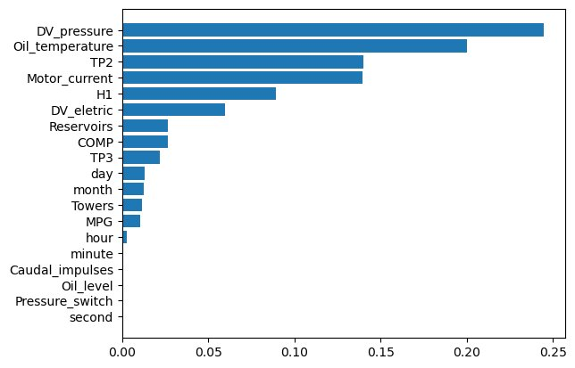
Feature Engineering & Feature Importance
What We Engineered
Dropped low-importance features
second, minute, Pressure_switch, Oil_level, Caudal_impulses
Dropped correlated features
TP3, LPS, MPG, COMP — highly correlated with others
Memory optimization
float64→float32, int64→bool — 2x memory reduction
Top features found
DV_pressure, Oil_temperature, TP2, Motor_current, H1

Slide 10
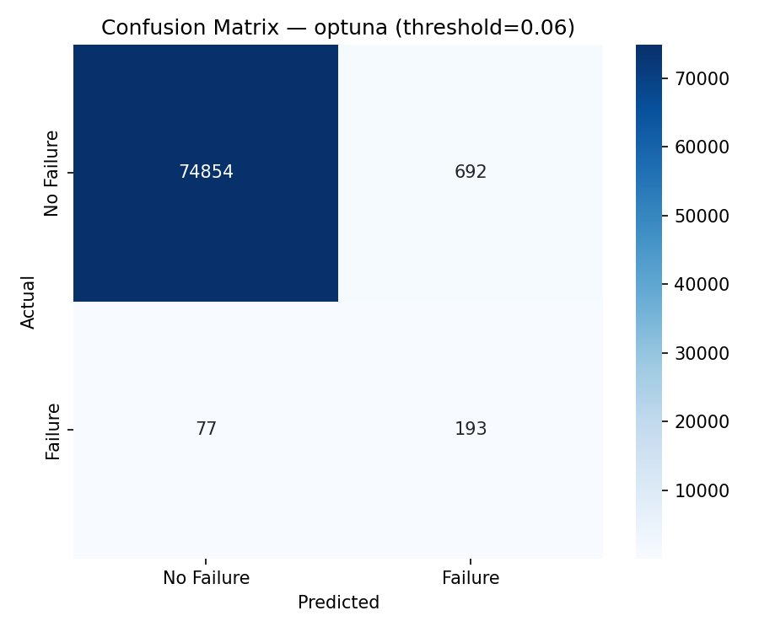
Hyperparameter Optimization with Optuna
Optuna vs RandomizedSearchCV
RandomizedSearchCV
✅ Simple, sklearn native
⚠️ Random — no memory of past trials
Optuna
✅ Bayesian — learns from trials
⚠️ More complex setup
Best Optuna Parameters
strategy=0.43 | n_est=358
max_depth=6 | threshold=0.06
⚠️ Dataset reduced to 1min resolution (300k rows) for tuning speed — 15M rows would take 5+ hours

Slide 11
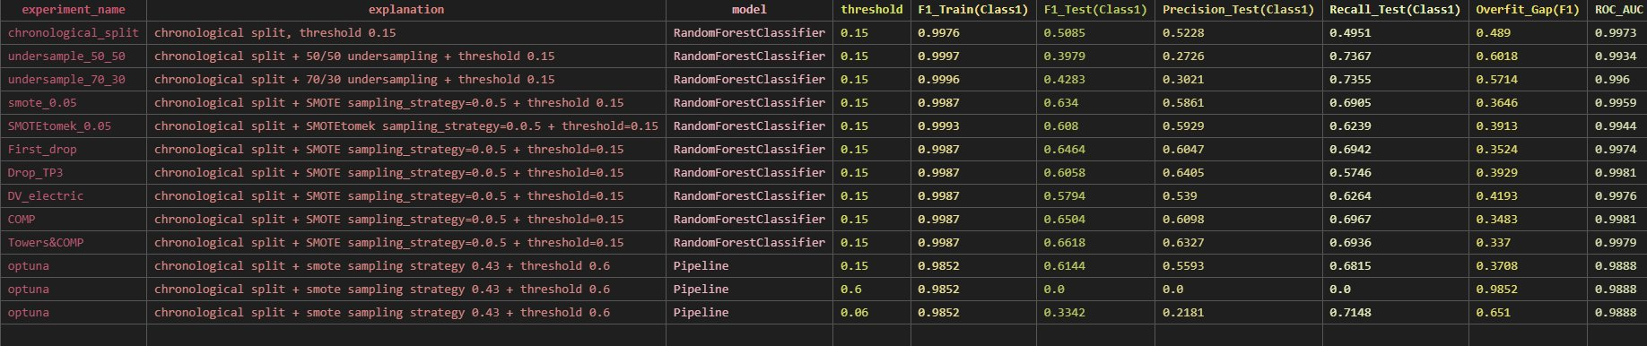
Results — All Experiments
🏆 SMOTE 0.05
0.691
0.634
0.586
0.364
Best overall balance
Recall
F1 Score
Precision
Overfit Gap

Slide 12
Lessons Learned
Accuracy is a trap with imbalanced data
Choose your target variable wisely
01
98% accuracy means nothing when 98% of data is one class. Always focus on Recall and F1 for the minority class.
02
We detect failures AS they happen — not before. Redefining target as pre-failure window is the real next step for predictive maintenance.
Threshold matters as much as the model
SMOTE beats undersampling for rare events
03
Default threshold of 0.5 catches zero failures. Lowering to 0.05-0.15 is essential when model probabilities are low due to class imbalance.
04
Generating synthetic minority samples preserves information. Removing majority samples wastes data — critical when failures are only 1.97%.

Slide 13
Future Work
🎯 Pre-failure window as target
🚀 Try XGBoost & LightGBM
Mark 1 week before each failure as class 1 — enables TRUE predictive maintenance, not just detection
Tree boosting models handle imbalanced data natively — likely to outperform Random Forest
🧠 Deep Learning — LSTM
🔧 Full resolution dataset
Sensor time series data is perfect for LSTM — captures long-term patterns before failure
Retrain on 15M rows with rolling window features to capture high-frequency sensor patterns

Slide 14
Thank You
Predictive Maintenance for Railway Air Compressor — MetroPT-3
69.1%
63.4%
10+
Best Recall
Best F1
Experiments
Alejandra Cardenas · Ironhack Data Science Bootcamp · 2026

